Slide 1
Data-driven Approach to Investigate the Effect of Temperature and Strain Rates on the Plastic Behaviour of Steel
Sayoojya Prasad
Aalto University
15/06/2023

Slide 2
Contents
Objective
General Workflow
Data
LSTM / RNN
LSTM Architecture and Specifics in this Study
Results
  Training results
  Testing results
Interpolation Task
  Stress vs. strain and initial temperature 3D plots
  Evolved temperature vs. strain and strain rate 3D plots

Slide 3
Objective
Wide application of steel in the automotive industry – plasticity plays a big role
Plasticity of steels are affected by external features such as temperature and strain rate
Machine learning to study the combined effect of strain rate and temperature on the plastic behavior of steel
Long-short term memory (LSTM) algorithm
Material: AISI 439
Machine learning is proved to be the most efficient modeling approach to solve this problem compared to experiments and conventional simulations

Slide 4
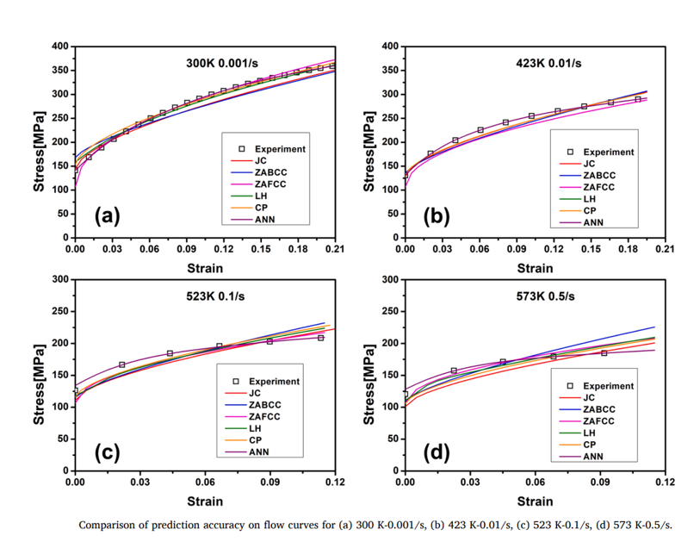
Existing ML Models
“Machine learning-based modeling of the coupling effect of strain rate and temperature on strain hardening for 5182-O aluminum alloy”
Hongchun Shang, Pengfei Wu, Yanshan Lou, Jizhen Wang, Qiang Chen
  ANN model to study the non-linear and coupled effect of strain rate and temperature
  Proved to be much more accurate and less time-consuming than traditional models
  Inputs: strain, strain rate, temperature at different strain levels
  Outputs: stress
  Limitations:
    does not predict evolved T
    Uses ANN for a sequence problem
Machine learning-based modeling of the coupling effect of strain rate and temperature on strain hardening for 5182-O aluminum alloy

Slide 5
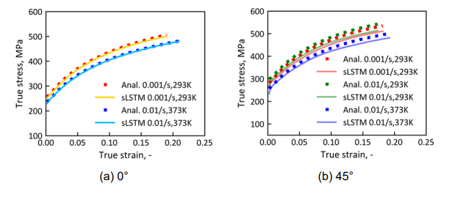
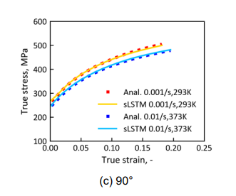
Existing ML Models
Isothermal Flow Curve Prediction
Training and testing primarily includes isothermal data (i.e. no increase in specimen temperature)
Isothermal model was built due to lack of data- difficult to record temperature increase in experiments
Manual isothermal correction was done to neglect effects of thermal softening
“Window shifting”
Inputs: strain, strain rate, temperature at (t), (t-1), (t-2)
Outputs: stress at (t)
Limitations:
  Ignores temperature increase
  Uses window shifting – model accuracy is greatly affected in its absence
Prediction results

Slide 6
Adiabatic Flow Curve Modeling using LSTM
LSTM model to overcome limitations of previous two models
  Can be used to model long sequences – enables the use of entire flow curves
  Uses past information as input for present – eliminates the need for window shifting approach
Evolved temperature as output - takes into account the thermal softening effect
Inputs: strain, strain rate, initial T
Outputs: stress, evolved T

Slide 7
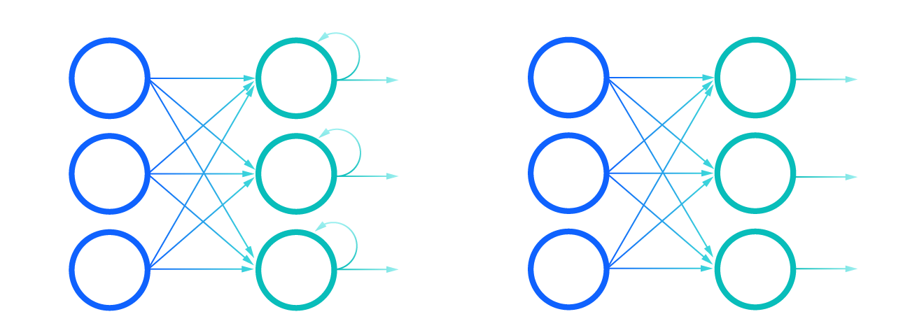
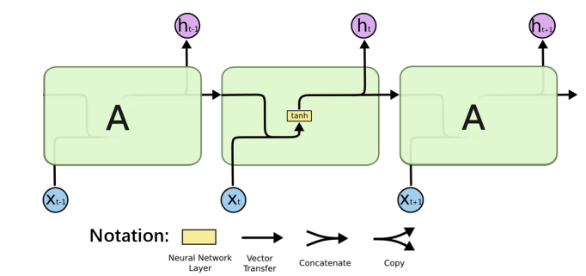
Long Short Term Memory and RNN
RNN (recurrent neural network) : used to model temporal data
They use their internal state (or memory) to process sequence of inputs (unlike feed-forward ANN)
Information from previous time steps/inputs used for prediction in current time step : interdependencies in sequential data is taken into account
Chain-like structure, hidden state carries info through the chain
RNN works well for short sequences
RNN vs ANN
https://www.ibm.com/cloud/learn/recurrent-neural-networks
A simple RNN architecture

Slide 8
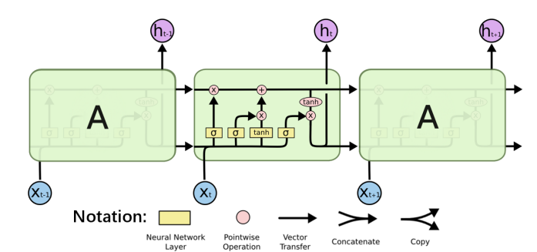
Long Short Term Memory and RNN
Similar structure as RNN
Key point: cell state that runs through the entire chain
LSTM can add or remove information in the cell state through different gates in each unit
1st step: what information should be removed
2nd step: what information should be stored
  Which values need to updated
  Which new values need to be added
3rd step: output of the unit is computed
This way, only necessary information is retained, and useless information is discarded.
Helps to model longer sequences

Slide 9
Data
Total 10 flow curves from experiments: 8 for training and 2 for testing
Stress-strain data available for all
Temperature evolution data available only for 0.01 /s and 0.1 /s strain rates at 293 K
Temperature does not evolve for rest of the flow curves in training set
Temp (K) | Strain Rate (/s)
 | 0.0001 | 0.000278 | 0.001 | 0.01 | 0.1
293 | ✓ | ✓ | ✓ | ✓ | ✓
373 |  | ✓ |  | ✓
473 |  | ✓
573 |  | ✓
673 |  | ✓
✓ Training
✓ Testing

Slide 10
LSTM Architecture and Specifics in this Study
Input layer
(3 units)
Inputs/Features: strain, strain rate, initial temperature
Outputs/Labels: stress, delta T (evolved T – initial T)
Data normalization
Hyperparameter tuning: to optimize right number of units per layer: Random search
Number of epochs (total number of iterations of training data): 75
Batch size (number of data samples processed before adjusting weights and biases): 64
Activation function (function to evaluate the output of a node/unit): RelU
Loss function (function to evaluate how close the predicted and real outcomes are): Mean squared error
1st hidden layer
(330 units)
2nd hidden layer
(290 units)
LSTM
Architecture
3rd hidden layer
(90 units)
Output layer
(2 units)

Slide 11
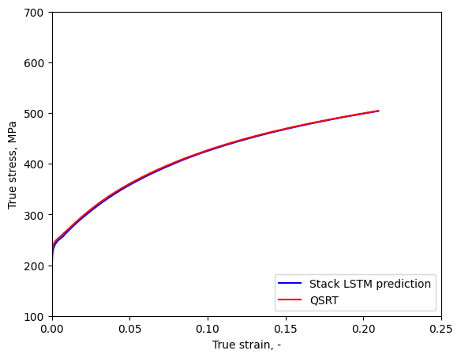
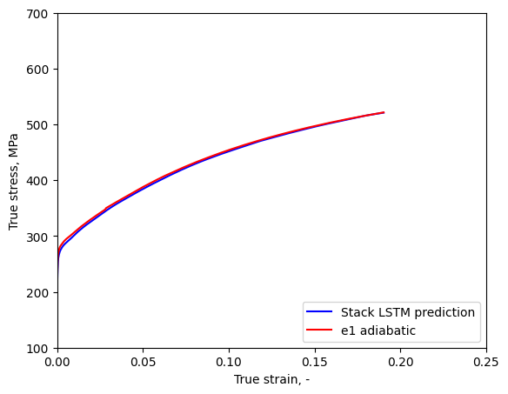
Preliminary Results
Training Results, Stress Prediction
Strain rate: 0.000278
Initial T: 293 K
r² score: 0.9989
Strain rate: 0.1
Initial T: 293 K
r² score: 0.9980

Slide 12
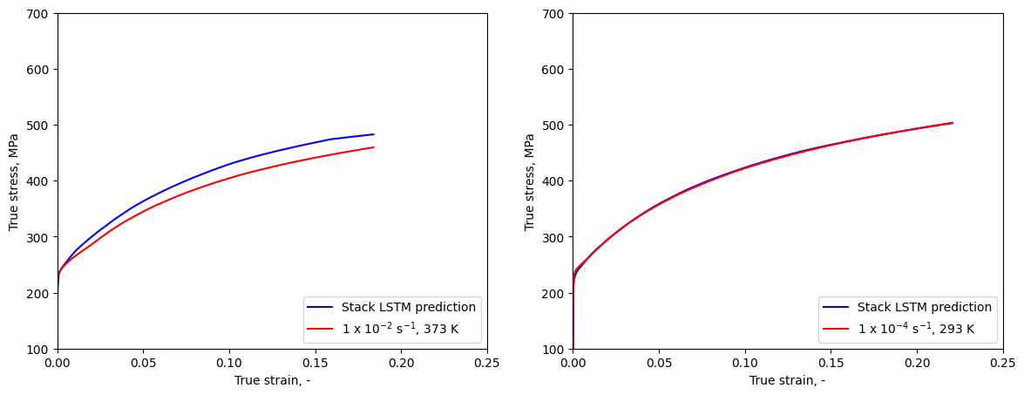
Preliminary Results
Testing Results, Stress Prediction
Strain rate: 0.01
Initial T: 373 K
r² score: 0.9076
Strain rate: 0.0001
Initial T: 293 K
r² score: 0.9984
Additional training data is likely to improve the prediction accuracy

Slide 13

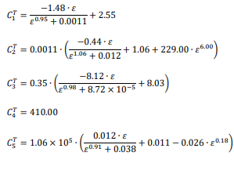




Analytical Model
Temperature dependent function:
Strain rate dependent function:
delta T function:
Stress function:
Strain rate sensitivity parameter m:
Parameters of temperature-dependent function f(T)

Slide 14
Modified Data
Total 25 flow curves from experiments + analytical model:
12 for training, 5 for testing and 8 for validation
Temp (K) | Strain Rate (/s)
 | 0.0001 | 0.000278 | 0.001 | 0.01 | 0.1
293 | ✓ | ✓ | ✓ | ✓ | ✓
373 | ✓ | ✓ | ✓ | ✓ | ✓
473 | ✓ | ✓ | ✓ | ✓ | ✓
573 | ✓ | ✓ | ✓ | ✓ | ✓
673 | ✓ | ✓ | ✓ | ✓ | ✓
✓ Training
Testing
Validation

Slide 15
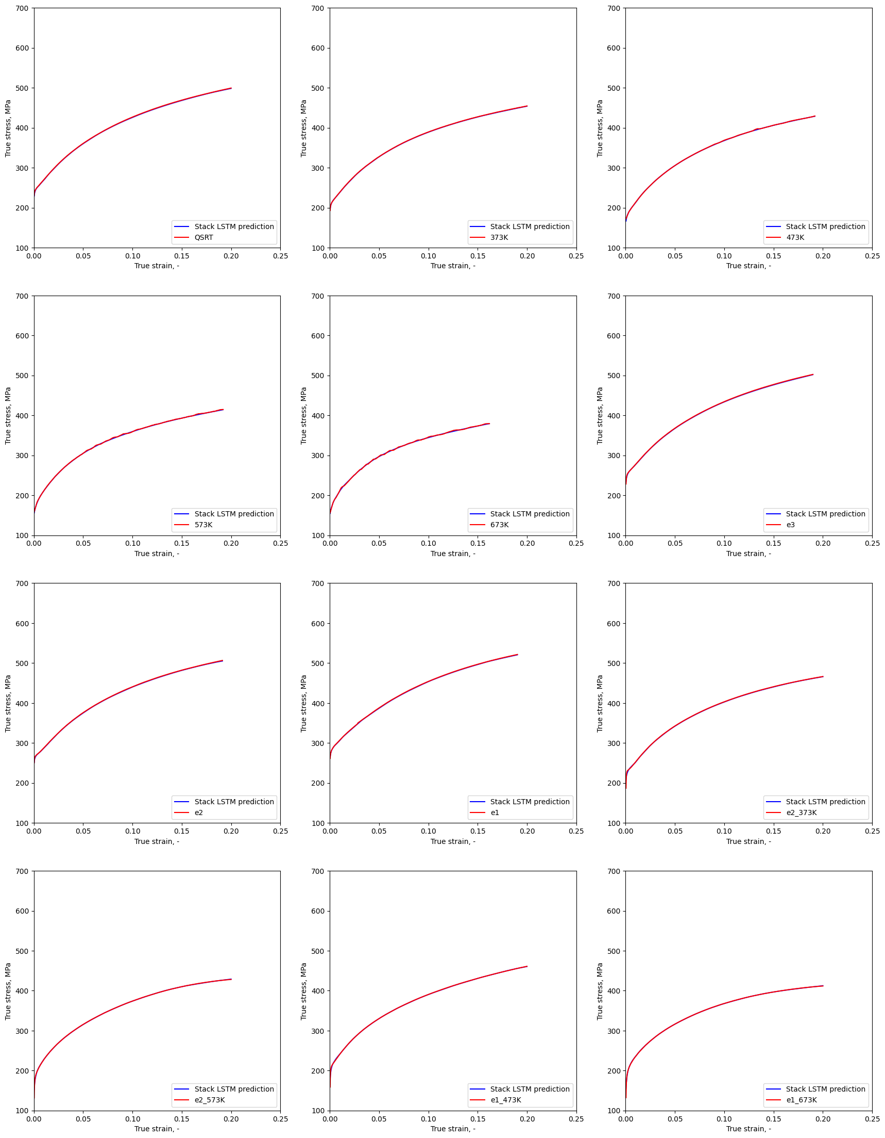
Results
Training Results, Stress Prediction
r² score > 0.999 for all cases

Slide 16
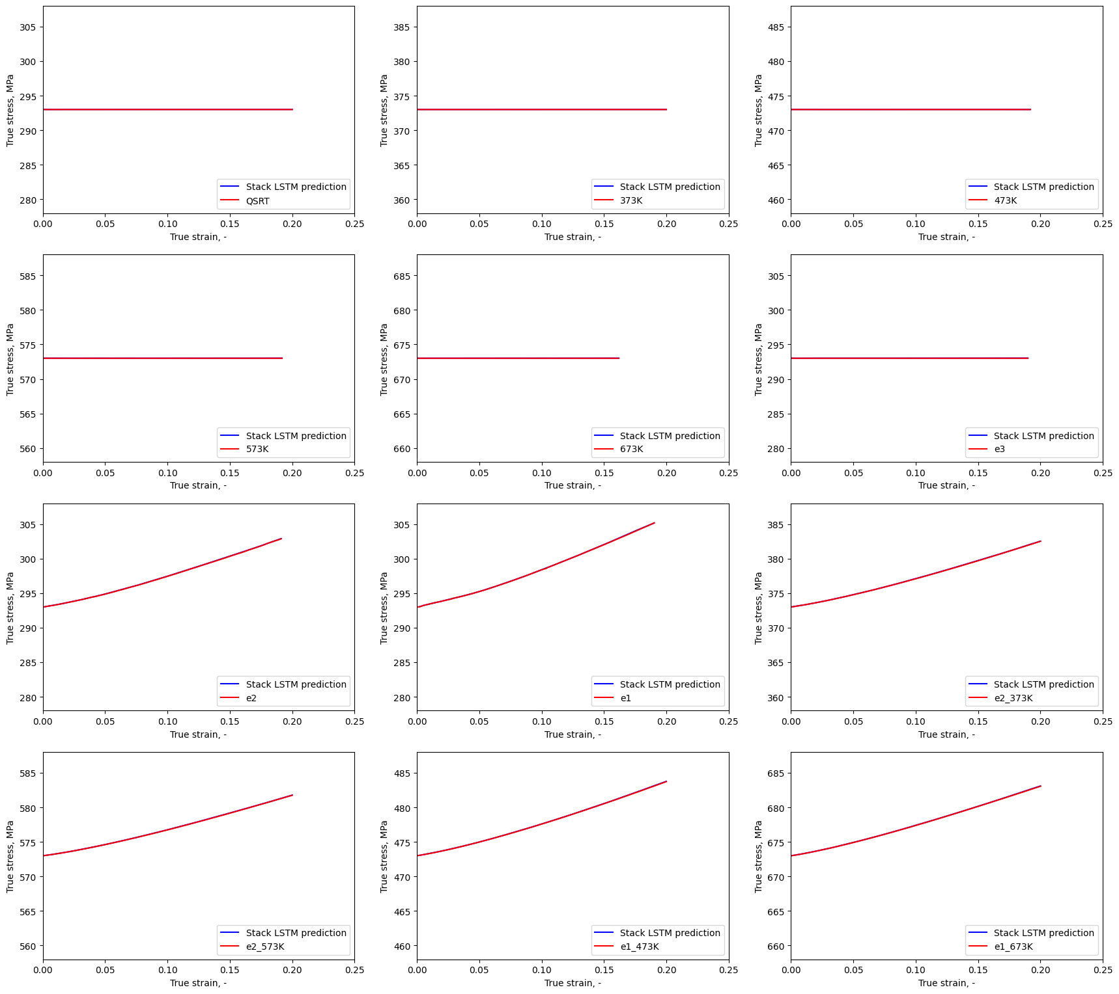
Results
Training Results, Temperature Prediction
r² score > 0.999 for all cases

Slide 17
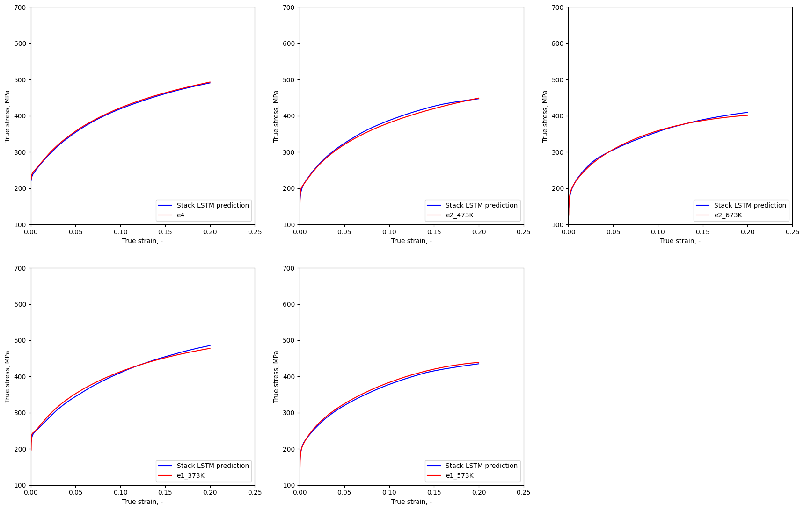
Results
Testing Results, Stress Prediction
r² score > 0.99 for all cases

Slide 18
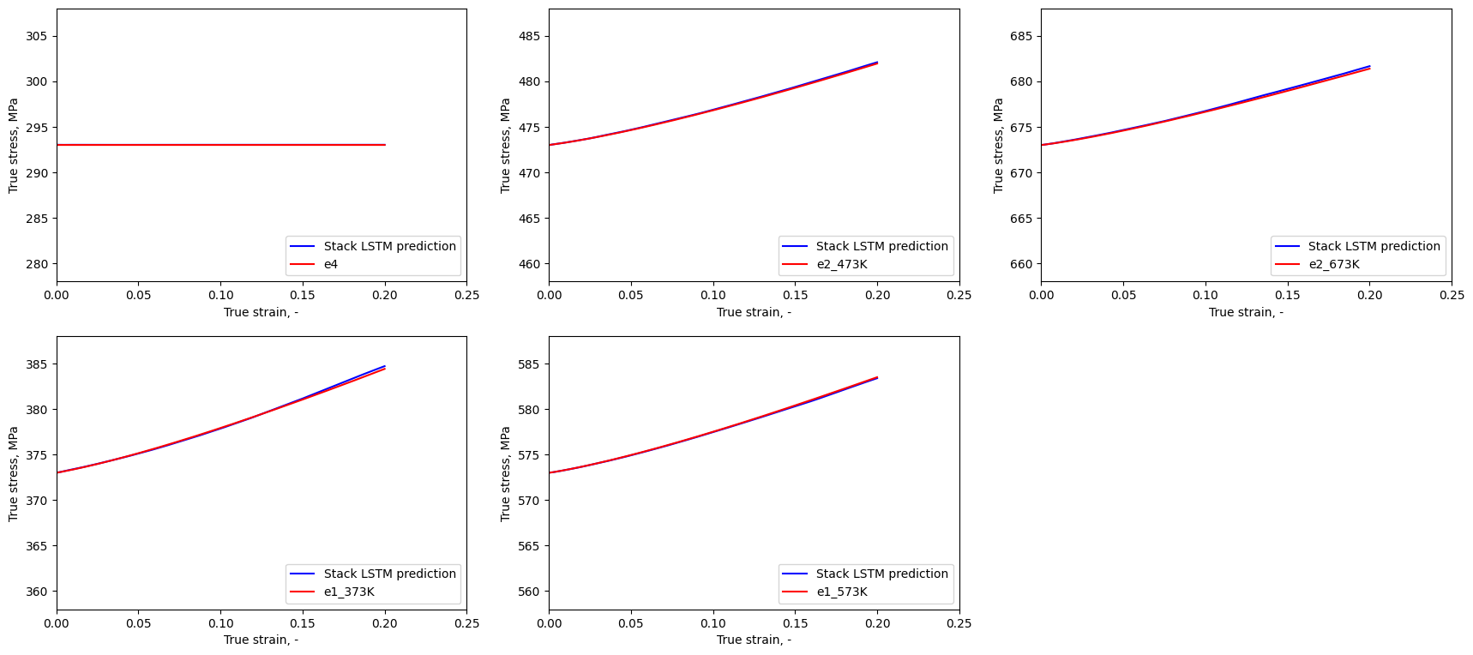
Results
Testing Results, Temperature Prediction
r² score > 0.99 for all cases

Slide 19
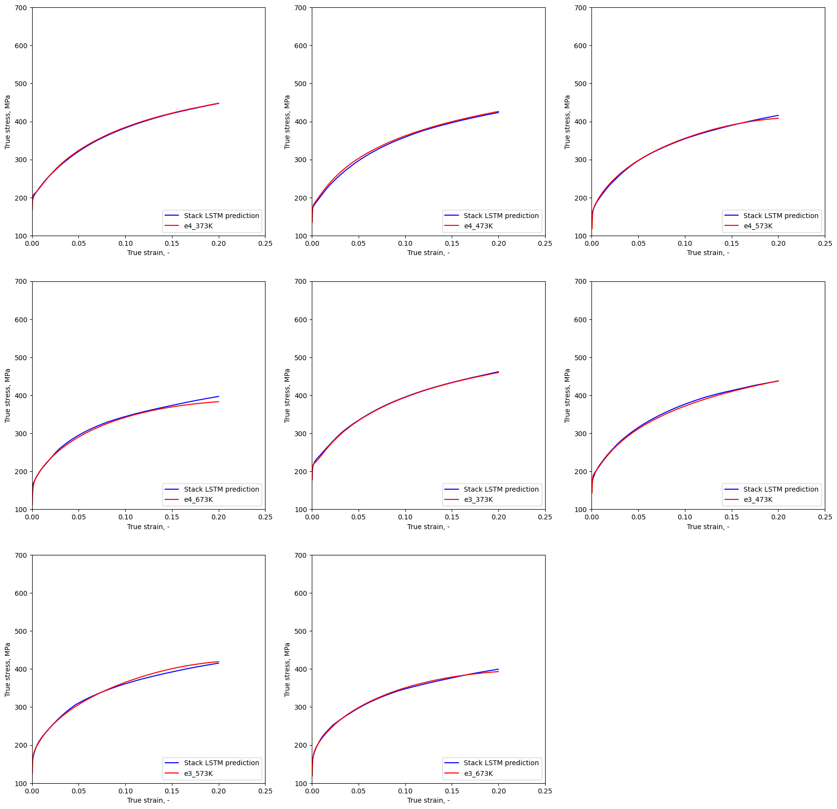
Results
Validation Results, Stress Prediction
r² score > 0.99 for all cases

Slide 20
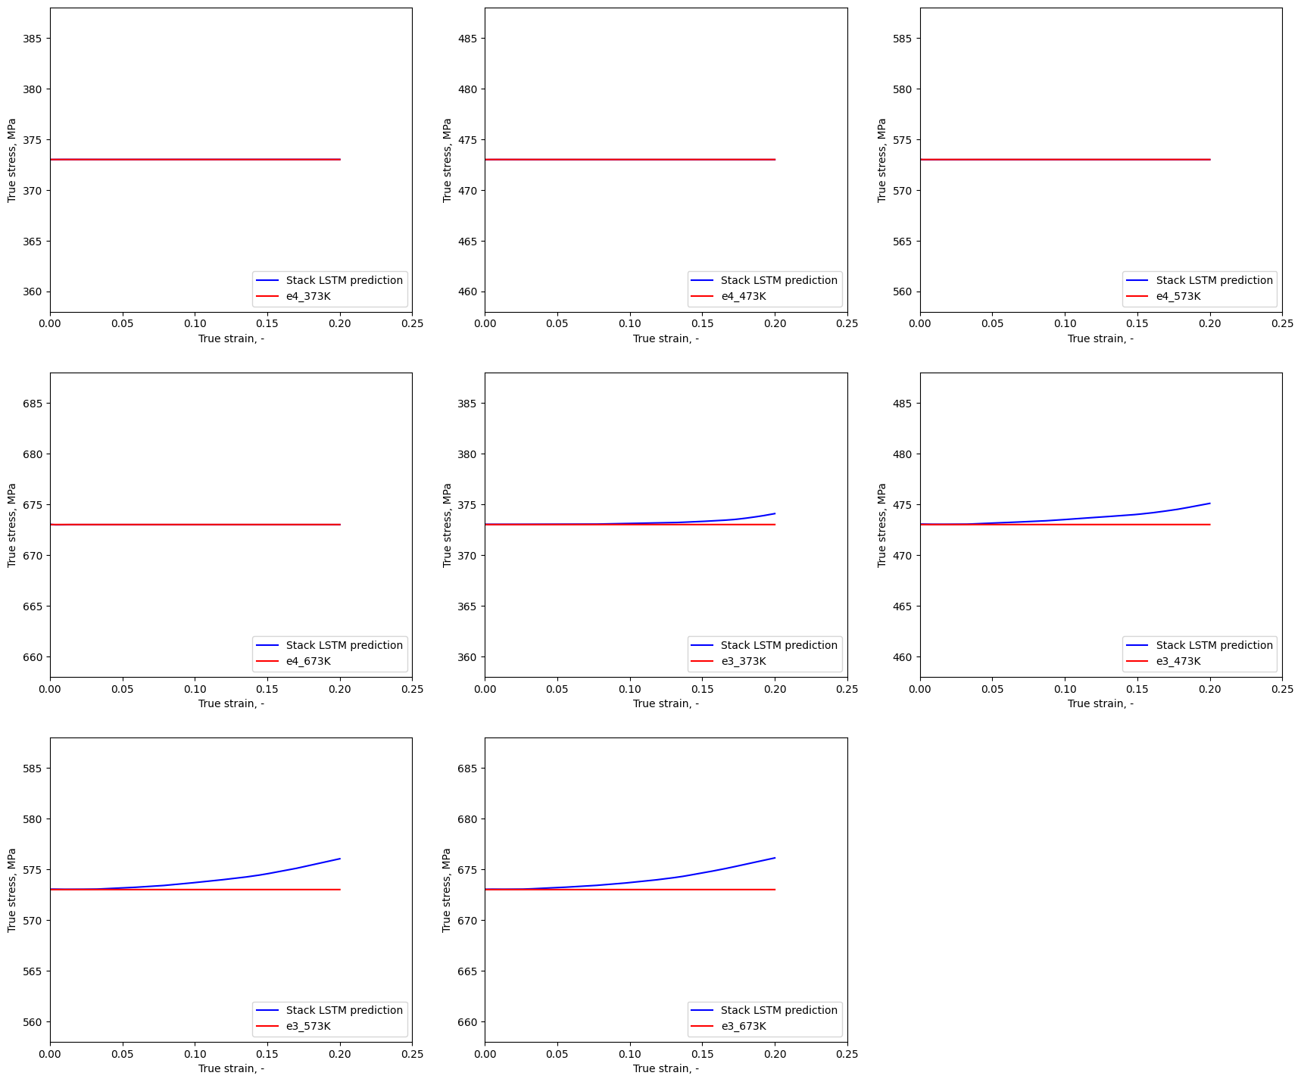
Results
Validation Results, Temperature Prediction
r² score > 0.99 for all cases

Slide 21
Interpolation Task
The trained ML model can be used to generate a high-fidelity dataset of different strain rates and temperatures that lie in the range of the training data
Produces thousands of flow curves in comparably much lesser time compared to experimental methods
Analyzing the produced dataset can help to identify patterns and facilitate further studies
Generates about 23000 flow curves
Feature | Interval | Step Size
Strain | 2e-8 to 0.2 | 0.001
Strain rate (log scale) | -4 to -1 | 0.01
Initial temperature (K) | 293 to 673 | 5

Slide 22
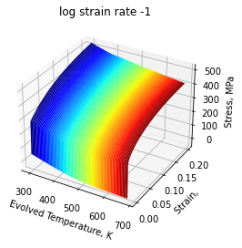
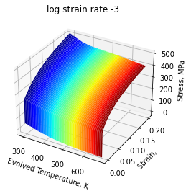

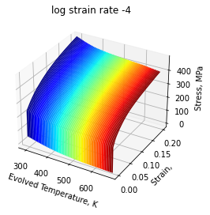
Interpolation Task
Stress vs. strain and initial temperature 3D plots

Slide 23
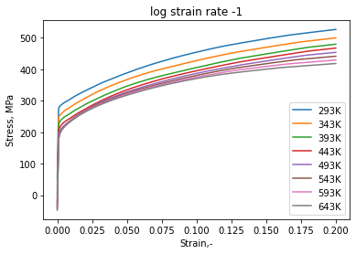
Interpolation Task
Stress at 0.2 value strain is decreasing with increasing temperature

Slide 24
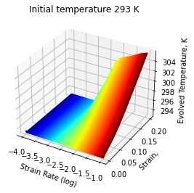
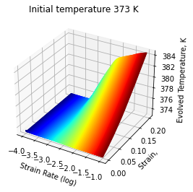
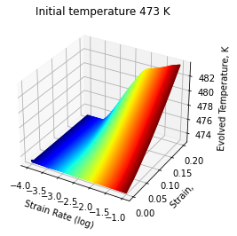

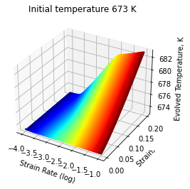
Interpolation Task
Evolved temperature vs. strain and strain rate 3D plots

Slide 25
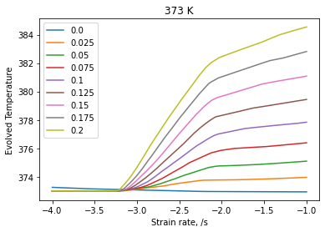
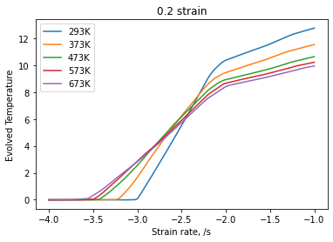
Interpolation Task
No T evolution for smaller strain rates
Smooth transition
Final evolved temperature is decreasing with increasing initial temperature

Slide 26
Conclusions
This study focuses on developing an LSTM model to study the effects of strain rates and temperature on the plastic behavior of AISI439
Two main novelties of this study:
  Predicts temperature evolution along with stress
  Uses LSTM algorithm as opposed to the normal feedforward ANN
Data engineering is a very important step in the development of machine learning models
The trained and validated LSTM model can be used to efficiently create a high-fidelity dataset within minutes

